Slide 1
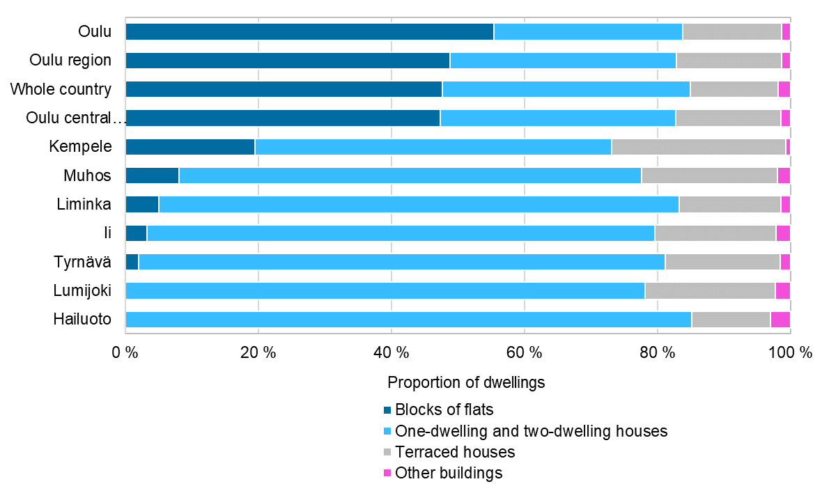
Dwellings by type of building and municipality, 2022
2023 regional boundaries
Source: Statistics Finland

