Slide 1
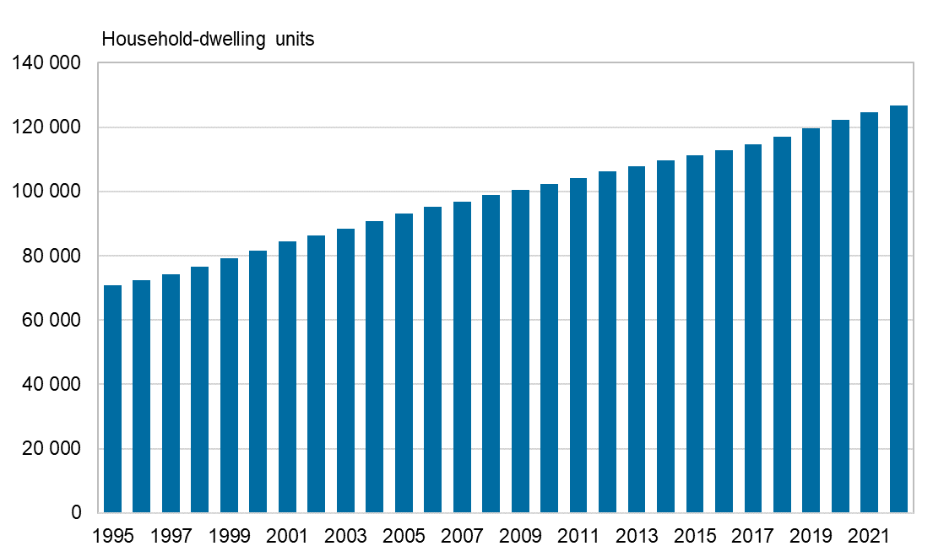
Household-dwelling units in the Oulu central region, 2005–2022
Source: Statistics Finland

