Slide 1
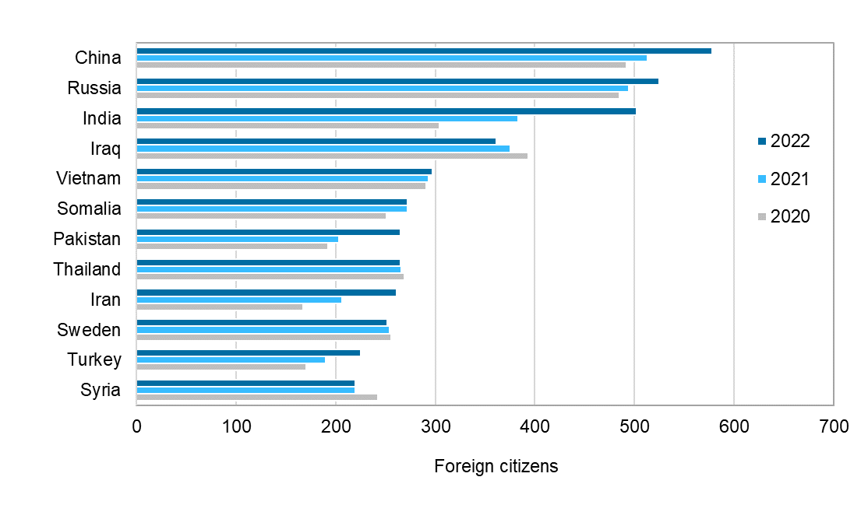
Largest groups of foreign nationals in the Oulu region, 2020–2022
2023 regional boundaries
Source: Statistics Finland

