Slide 1
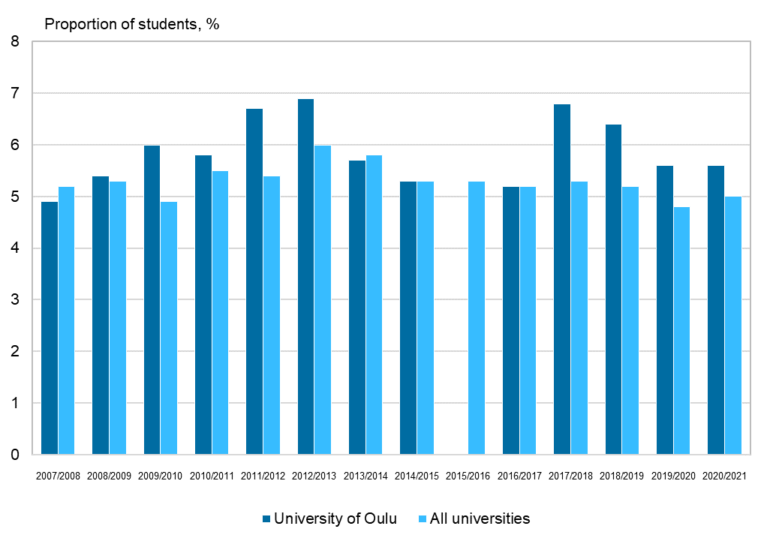
Discontinuation of education in the University of Oulu and all universities, 2007–2021
*Data missing
Source: Statistics Finland

